Slide 1

The Family Check-Up
®
® Family Check-Up is a federally registered trademark owned by the University of Oregon
Purveyor
Northwest Prevention Science
Presenter
Anne Marie Mauricio, PhD
Model Developer
Elizabeth Stormshak, PhD

Slide 2

Family Check-Up
Brief, family-centered, strengths-based
Combines assessment with motivational interviewing to engage families and bridge to other services
Tailored to the strengths and needs of individual families
This Photo by Unknown Author is licensed under CC BY-NC

Slide 3
Evaluations
1000’s of families in several randomized control trials
Across urban and rural communities nationally and internationally
With culturally, socioeconomically diverse families & internationally
Many different service settings
Notes:
Impacts a broad range of child outcomes
More than 30 years of research support strong intervention effects
Sample
2/3 = annual family income of less than $20,000 during the 2002–2003 screening period.
41% of mothers had a high school diploma or GED equivalence,
32 % had 1 to 2 years post-high school education.
Only 27% had college degree
50.1 % of the children were European American, 27.9 % were African American, 13.4 % were Hispanic American, 13.0 % were biracial, and 8.9 % other
Add studies from adolescence….
How many studies (0ver 1000,s of families, # sites, diversity of settings, families)
Ubiquitous, all over….

Slide 4
Theory of Change
Family Check-Up
Parenting, Family Relationships and Processes
Child Outcomes
Notes:
Target child problem behavior by improving family dynamics and parenting practices

Slide 5

Impact:
Early Childhood
Fewer behavioral and emotional problems at school and home
Improved ability to regulate emotions
Improved academic performance
Increased school readiness
Improved health outcomes
Reduced risk for child abuse neglect
This Photo by Unknown Author is licensed under CC BY-SA

Slide 6

Impact:
Adolescence
Decreased substance use/abuse
Decreases delinquency, arrests
Improved grades and attendance
Decreased depression and risk for suicidality
This Photo by Unknown Author is licensed under CC BY-NC

Slide 7

Culturally Responsive
Collaboration is Key: Equal power balance in the relationship
Assessment informed by cultural context
Caregiver as expert
  Drop assumptions about what we think we know about other’s cultural experiences
  Evidence that intervention effects are consistent across White, Black, and Latinx families
This Photo by Unknown Author is licensed under CC BY-SA-NC

Slide 8
Recognition
Maternal Infant and Early Childhood Home Visiting Program (MIECHV)
Title IV-E Prevention Services Clearinghouse
California Evidence Based Clearinghouse
Blueprints
Early Intervention Foundation (UK and Scotland)
Blueprints for Healthy Development

Slide 9
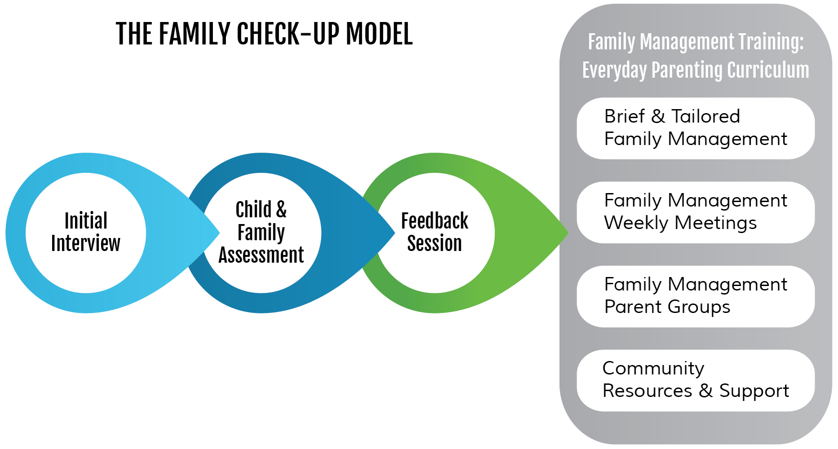
Everyday Parenting
Community Resources and Supports
Caregiver behavioral health
Resource Needs-housing, employment
Home-School Connection

Slide 10
Current/Future Directions:
Family-Check Up Online

Slide 11
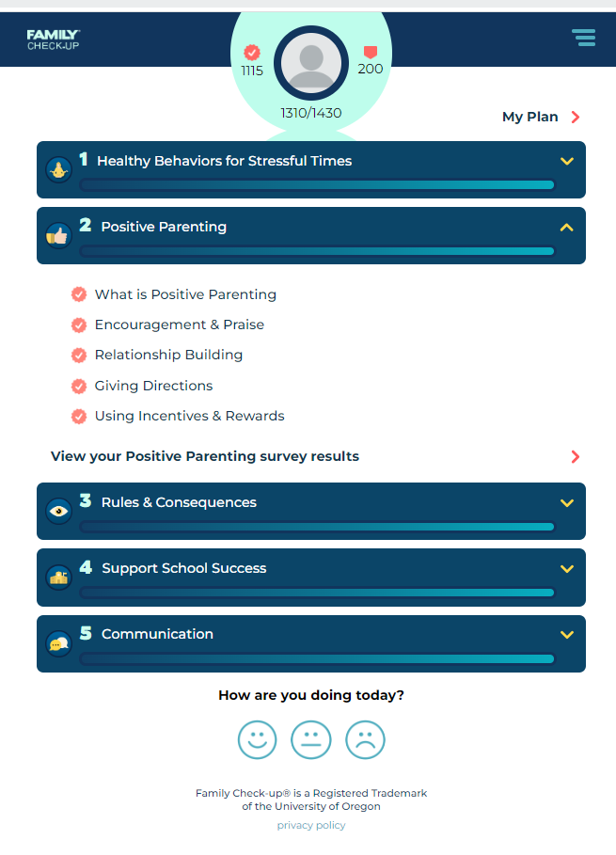
Given strong evidence, Family Check-Up adapted for telehealth delivery
Online program via smartphone with self-paced content and interactive experiences
Brief assessments to understand parenting strengths and challenges and tailor program
Daily text messages encourage practice of the skills
Individualized telehealth 20 to 30-minute coaching sessions

Slide 12
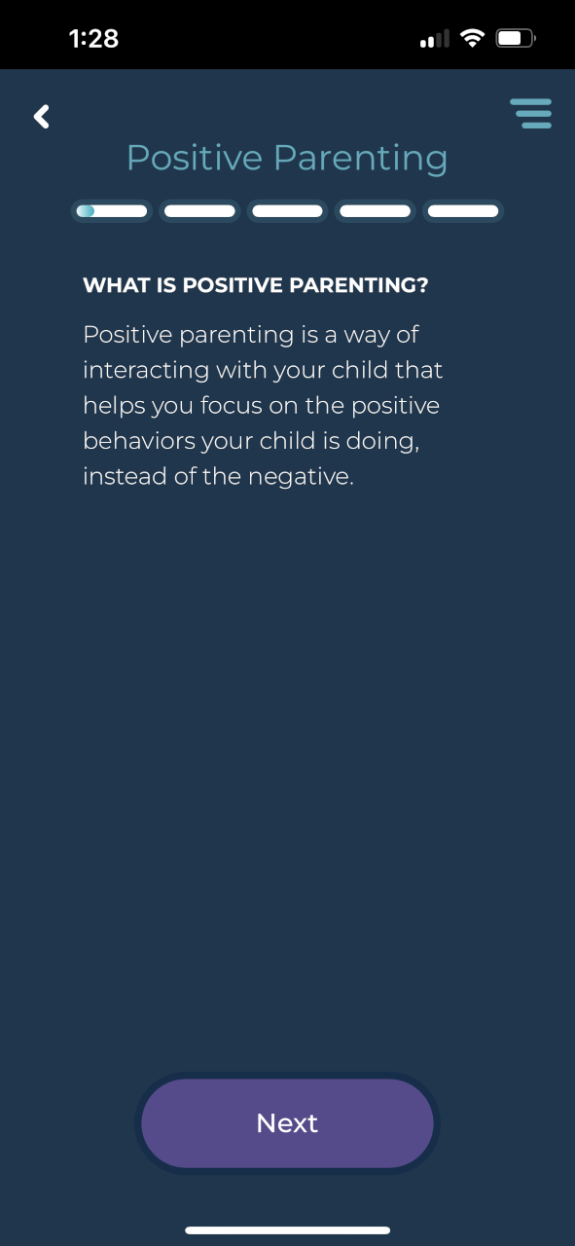
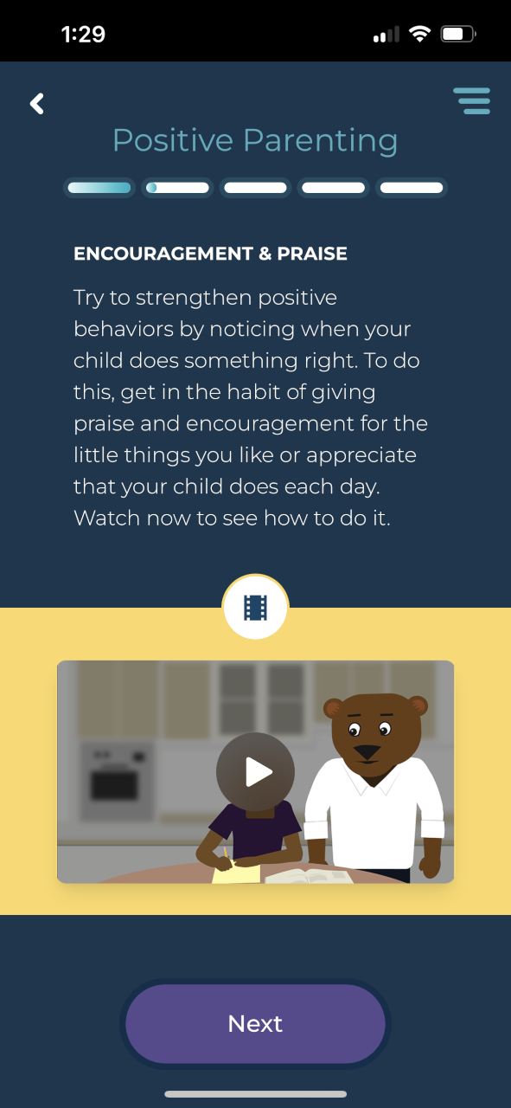
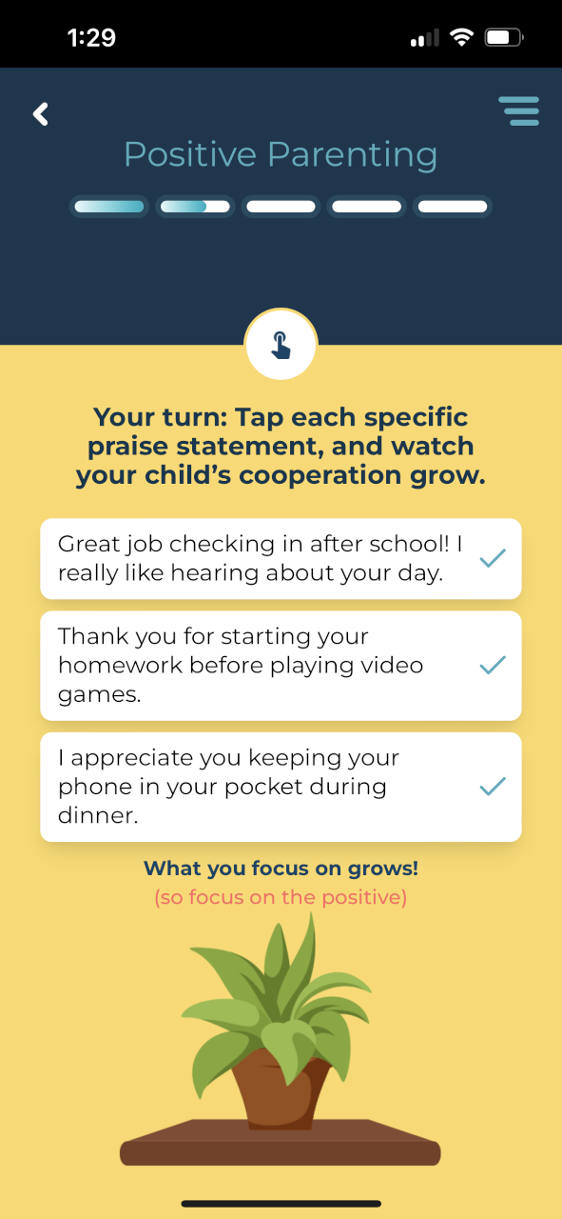
The Caregiver Content Experience: Positive Parenting

Slide 13
Individualized Coaching for Parents
Support parents’ development and practice of the skills
Feedback on assessment results- strengths and focus areas
Set goals for use of skills
Practice skills in session
Explore barriers
Flexible in frequency, length, modality

Slide 14

Caregiver Testimonials
"I love the text messages, they come in at the times I need them. I am reminded to breathe, offer specific praise to my kids, or do something I enjoy to improve my parenting."
“The information was so helpful. I was able to use it right away. I learned to ask [my child] for one thing at a time and to praise her after she did it. And it works. It has made such a difference.”
“I have noticed I am more conscious of my parenting day to day, and it’s brought positive and proactive parenting strategies to the forefront of my mind, and I’ve been able to put these skills into action. I wasn’t expecting that, but it has actually made a big difference.”
This Photo by Unknown Author is licensed under CC BY

Slide 15
Parenting Young Children (PYC) Project
What we want to know: Is the Family Check-Up Online for early childhood effective?
Past projects: Middle school study (75 families) and Josephine and Douglas county pilot (10 families)
Current project: Parenting Young Children (NIH)

Slide 16


Ongoing Parenting Young
Children Project:
Who Can Participate?
Parents/caregivers of children 18 months to 5 years old who live with child 50% of time
Have a Smart Phone with text messaging capability and access to email
Experiencing stressors associated with raising young children
Speak Spanish or English
Willing to complete phone interviews and use a smartphone parenting program

Slide 17

What Does Participation Involve?
Parents complete four 1-hour surveys (via private phone interview or online link) over a year, each approximately 3 months apart
Engagement in Family Check-Up Online program
Some parents get Family Check-Up Online and Coach immediately
Others get access to Family Check-Up Online one year after initial participation
Parents receive up to $475 over the course of a year
www.parentingyoungchildren.org

Slide 18

QUESTIONS
&
THANK YOU! amariem@uoregon.edu

